Slide 1







Prompt
Engineering
Your Prompts matter...

Slide 2

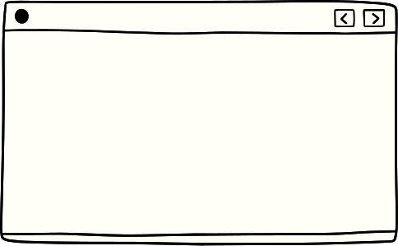


“Modern-day Alchemists who can convert
simple Text into Digital Gold/Art”

Slide 3

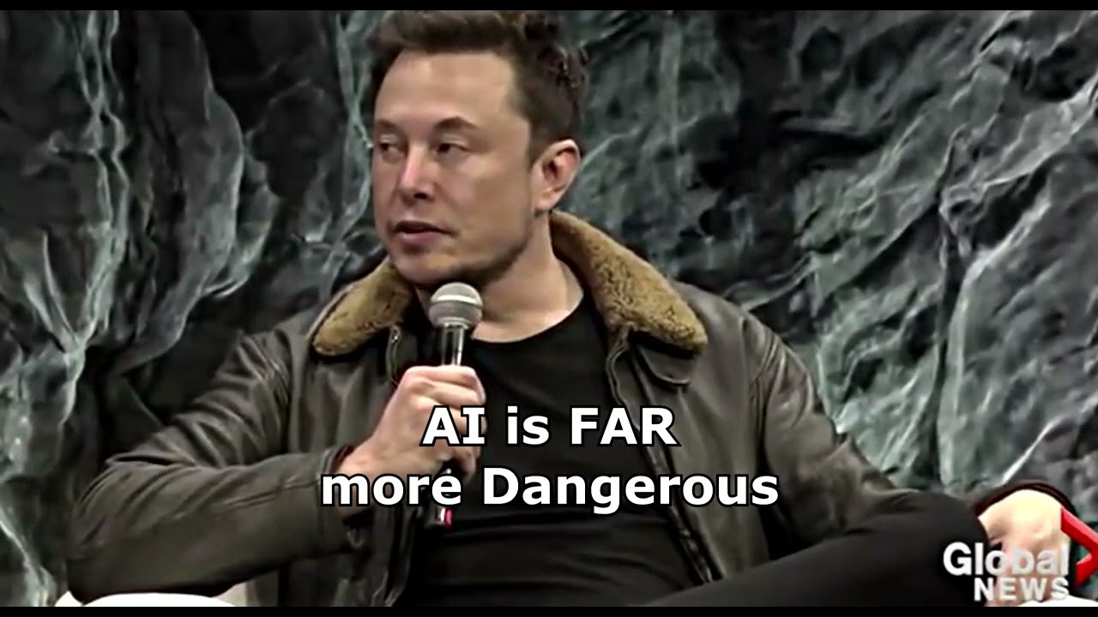



Slide 4
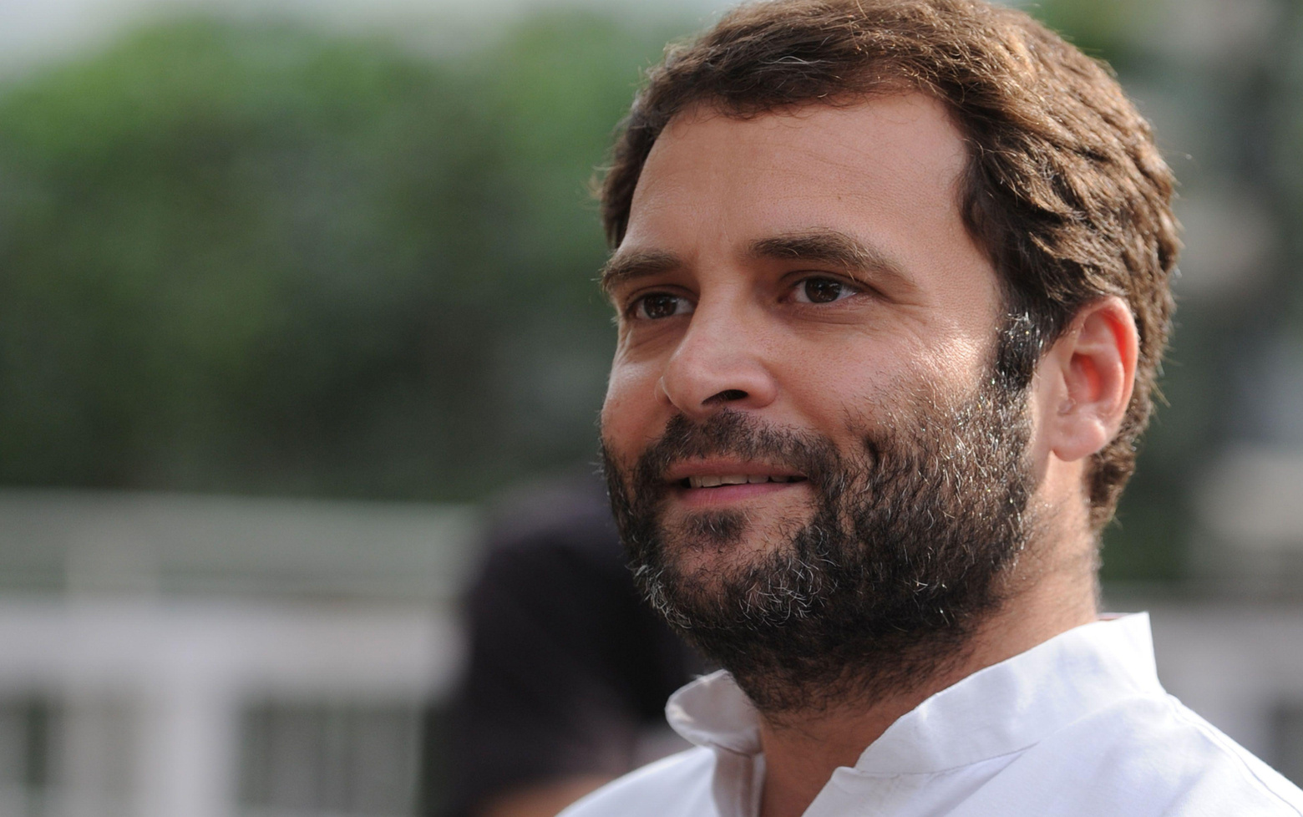
Rule 1
“Give Clear and specific Instructions !”

Slide 5
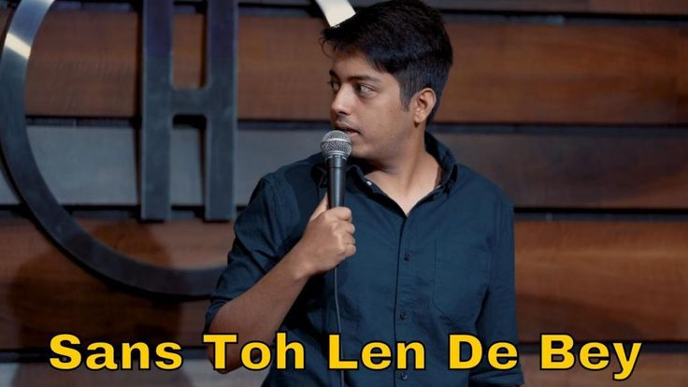
Rule 2
“Give the model Time to Think !”

Slide 6




Flaws of GPTs
Too
Creative
Prompt Injection
Prompt Leaks
Manipulation

Slide 7

Too Creative
Doesn't know the difference between fictional and real

Slide 8
Prompt Injection
Aims to elicit an unintended response from LLM-based tools

Slide 9
Prompt Leaks
exposes more information in the prompt

Slide 10
Manipulation

Slide 11







Work with APIs

Slide 12



Streamlit
Streamlit turns data scripts into shareable web apps in minutes.
All in pure Python. No front‑end experience required.

Slide 13

Thank you

